Slide 1
BASICS OF HTML FORMATTING AND FONTS
PRESENTED BY:
BHUMIL LAKHTARIYA
150410107009
TY CE-1
BATCH A

Slide 2
The Elements – Heading Tag
Any documents starts with a heading.
You use different sizes for your headings.
HTML also have six levels of headings, which
use the elements <h1>, <h2>, <h3>, <h4>,
<h5>, and <h6>.
While displaying any heading, browser adds
one line before and after that heading.

Slide 3
Centering Content - <center> Element
Use <center> tag to put any content in the center of the page or any table cell.
Example
<p>This is not in the center.</p>
<center><p>This is in the center.</p></center>
result
This is not in the center.
This is in the center.

Slide 4
Example – Heading Tags
<html>
<head><title>Heading Tags</title></head>
<body>
<h1>This is heading 1</h1>
<h2>This is heading 2</h2>
<h3>This is heading 3</h3>
<h4>This is heading 4</h4>
<h5>This is heading 5</h5>
<h6>This is heading 6</h6>
</body>
</html>

Slide 5
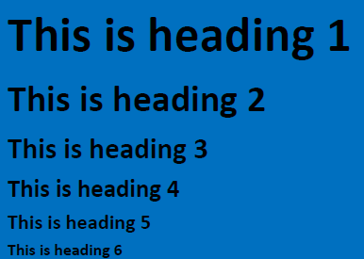
Example – Heading Tags

Slide 6
Create Paragraph - The <p> Element
The <p> element offers a way to structure your text.
Each paragraph of text should go in between an opening <p> and closing </p> tag

Slide 7
Example - <p> Parag tag
<html>
<head><title>Paragraph Tag</head>
<body>
<p>Here is a paragraph of text.</p>
<p>Here is a second paragraph of text.</p>
<p>Here is a third paragraph of text.</p>
</body>
</html>

Slide 8
Result of paragraph tag
Here is a paragraph of text.
Here is a second paragraph of text.
Here is a third paragraph of text.

Slide 9
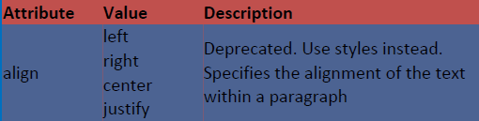
<p> - align attribute
You can use align attribute to align your paragraphs.

Slide 10
Presentational Tags
If you use a word processor, you are familiar with the ability to make text bold, italicized, or underlined; these are just three of the ten options available to indicate how text can appear in HTML and XHTML.
– Bold Text - The <b> Element
– Italic Text - The <i> Element
– Underlined Text - The <u> Element

Slide 11


Line Breaks - The <br /> Element:
The HTML <br /> tag is used to give a line break.
In HTML the <br> tag has no end tag.
In XHTML the <br /> tag must be properly closed.

Slide 12
<font > tag
The HTML <font> tag is used to specify the font of the text.
The font element is deprecated in HTML as well as in XHTML. So start using CSS.

Slide 13
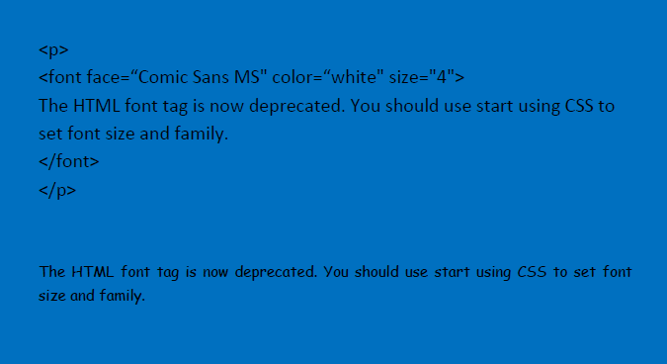
<font > tag

Slide 14
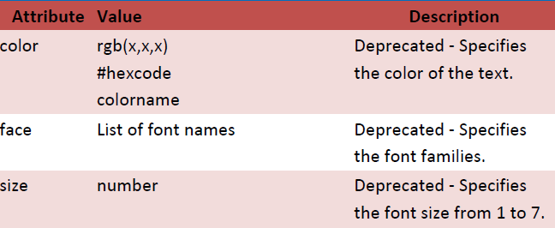
<font > tag attributes

Slide 15
Strike Text - The <strike> Element
Anything that appears in a <strike>...</strike> element is displayed with strikethrough, which is a thin line through the text.
example
<p>The following word uses a <strike>strikethrough</strike> typeface.</p>
Result

Slide 16
Monospaced font - The <tt> Element
The content of a <tt> element is written in monospaced font.
Most fonts are known as variable-width fonts because different letters are of different widths (for example, the letter m is wider than the letter i).
In a monospaced font, however, each letter is the same width.

Slide 17


Monospaced font - The <tt> Element

Slide 18
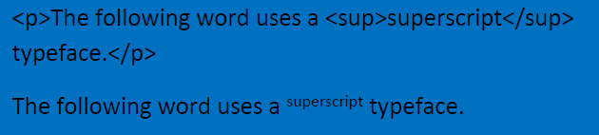
Superscript Text - The <sup> Element
The content of a <sup> element is written in superscript; the font size used is the same size as the characters surrounding it but is displayed half a character.s height above the other characters.

Slide 19
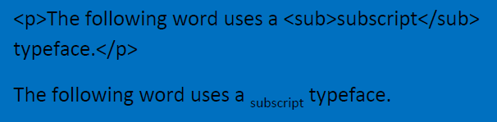
Subscript Text - The <sub> Element
The content of a <sub> element is written in subscript; the font size used is the same as the characters surrounding it, but is displayed half a character.s height beneath the other characters.

Slide 20

Nonbreaking Spaces
Suppose you were to use the phrase "12 Angry Men." Here you would not want a browser to split the "12" and "Angry" across two lines:
A good example of this technique appears in the movie "12 Angry Men."

Slide 21
Preserve Formatting - <pre> Element
you want your text to follow the exact format of how it is written in the HTML document. In those cases, you can use the preformatted tag (<pre>).
Any text between the opening <pre> tag and the closing </pre> tag will preserve the formatting of the source document.

Slide 22
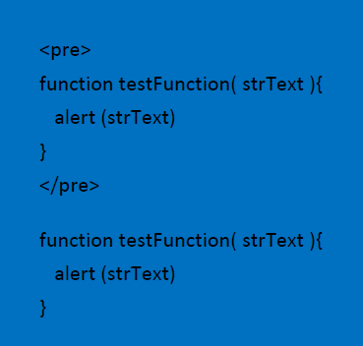
Preserve Formatting - <pre> Element

Slide 23
THANK YOU

